Slide 1
CST-235 Computer Programming III
Topic 3 (2 weeks)

Slide 2
Enterprise Java Beans (EJB)

Slide 3
Lectures for Topic 3
Lectures:
Business Services Layer:
Stateless EJB => Week 1
CDI => Week 1
Timer EJB => Week 2
Hands On:
Build a Stateless EJB.
Inject EJB into a Controller.
Build a Timer EJB.

Slide 4
Lectures for Topic 3 – Week 1
Lectures:
Topic 3 Project Assignment Requirements.
Business Services Layer:
Enterprise Java Beans
Dependency Injection
Hands On:
Build a Stateless EJB.
Inject an EJB into a Controller.

Slide 5
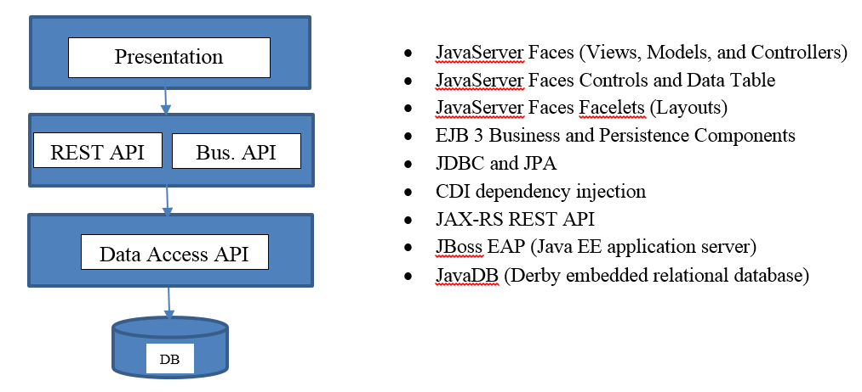
Project Overview
In this class you will design and build a complete enterprise class N-Layer application using Enterprise Java technologies, that meets a certain set of functional and technical requirements, and as shown in the figure below.

Slide 6
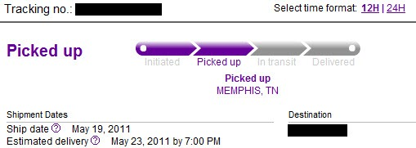
What is business logic?
Prescribes how business objects interact with one another.
Business logic is the portion of an enterprise system which determines how data is transformed or calculated, and how it is routed to people or software (workflow).
What will be your business logic for your application?

Slide 7
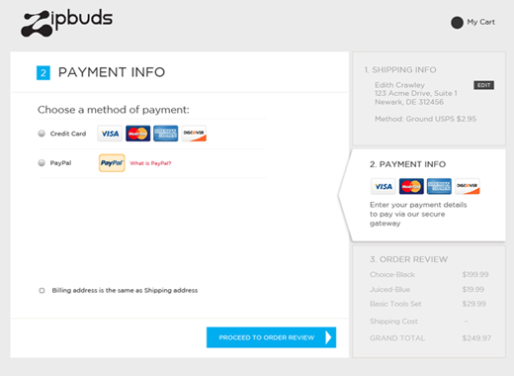
What is business logic?
For example for an eCommerce site: Allow visitors to add items to a shopping cart, specify a shipping address, and supply payment information.
What will be your business logic for your application?

Slide 8
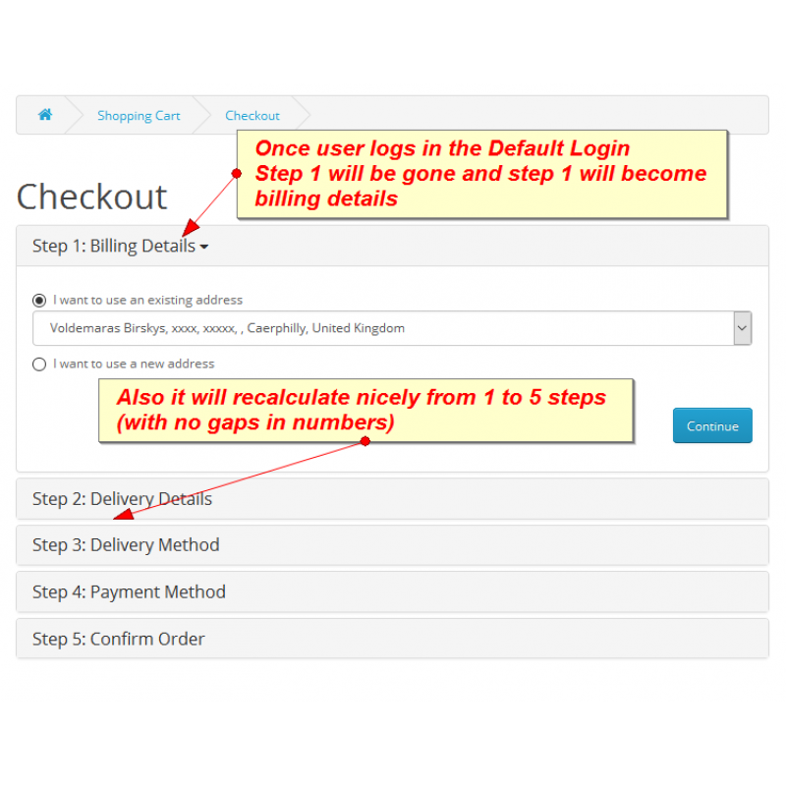
What is business logic?
The business logic of the website might include workflow such as: The sequence of events that happens during checkout, which first asks for the shipping address, then for the billing address, next page will contain the payment method, and last page will show congratulations. Think workflow, what tasks, and what order.
What will be your business logic for your application?

Slide 9
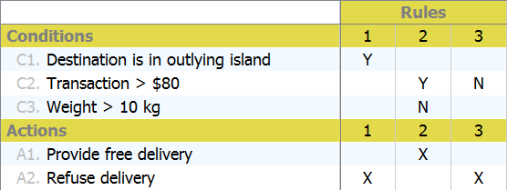
Business Logic – Decisions to be made…

Slide 10

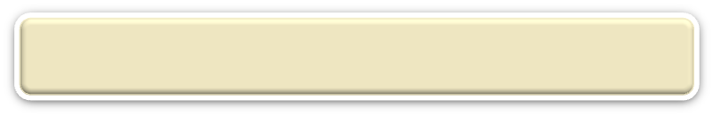
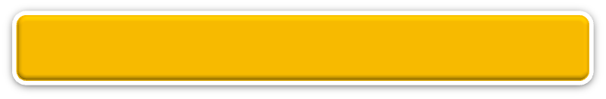
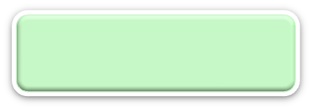


N-Layer Architecture
RIA Design
Client Layer (Desktop/Mobile/Browser)
User Interface, (Minimal) Client Side Validation, AJAX, UI Rules
AJAX
jQuery
CSS
Forms
HTTP/HTTPS POST
This layer is all about handling executing business logic, business rules, and interacting with Data Services
Event Based Design
Presentation Layer (PL)
User Interface, UI Event Handlers, UI Rules, Navigation
JSF
Data Validators
Canonical Object Model
Local POJO, SOAP, REST
Design By Contract
Business/Services Layer (BLL)
Business Logic, Business Rules, Workflow, Data Validation
EJB
IoC/CDI
JAX-WS and JAX-RS
Canonical Object Model
Canonical Object Model
Optional SOAP, REST
SOAP, REST
Entity Driven Design
Data Access/Services Layer (DAL)
CRUD Data Persistence
Integration Tier
Orchestration
(Workflow*, Rules*)
Entity Beans (ORM)
Hibernate
Data Access Objects
Data Model
JMS, SOAP, .JAXB, Spring
Cache
Operational
Database
External Systems
Interfaces, Feeds, Printers
Business Entity
Media

Slide 11
What is a business rule?
A business rule is a rule that defines or constrains some aspect of business and always resolves to either true or false.
Business rules describe the operations, definitions and constraints that apply to an organization.
Business rules can apply to people, processes, corporate behavior and computing systems in an organization, and are put in place to help the organization achieve its goals.
For example:
No credit check is to be performed on return customers.
Cannot withdraw more money from your account then your balance.
Cannot buy items with a credit card if the card authorization fails.
What are other business rules do you have in your application?

Slide 12
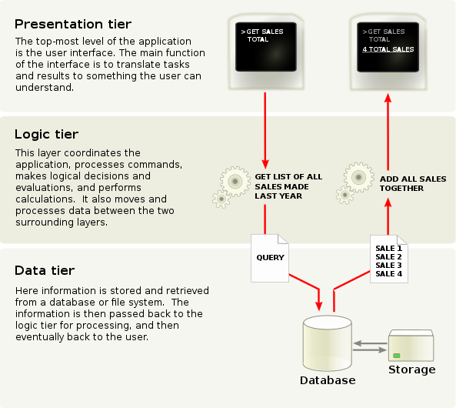
ResponsePage.xhtml
InputForm.xhtml
AnnualReport.xhtml
Business logic is the layer we are working in.
BusinessLogic.java
DabaBaseOps.java

Slide 13
Example Business Logic for a shopping cart
public class Cart {
private int itemCount;
private double totalPrice;
private static int capacity;
private static Item[] cart = new Item[capacity];
public Cart(){
itemCount = 10;
totalPrice = 0.0;
capacity = 0;
}
public void add(int itemID, String itemName, double itemPrice, String itemDescription, int itemQuantity, double itemTax){
Item item = new Item(itemID, itemName, itemPrice, itemDescription, itemQuantity, itemTax);
totalPrice += (itemPrice * itemQuantity);
cart[itemCount] = item;
itemCount += 1;
if(itemCount==capacity)
{
increaseSize();
}
}
more methods to follow...

Slide 14
Business Logic (another example)
public class Product {
public Product (string name, decimal price) {
this.Price = price;
this.Name = name;
}
public decimal GetPrice() { return this.Price; }
public override string ToString () {
return name + " " + price;
}
}
public class Cart {
protected List<Product> items;
public void AddItem( Product newItem ) { }
public decimal CartTotal() {
decimal total = 0;
foreach (Product thing in items) { total += thing.GetPrice(); }
return total;
}
}

Slide 15
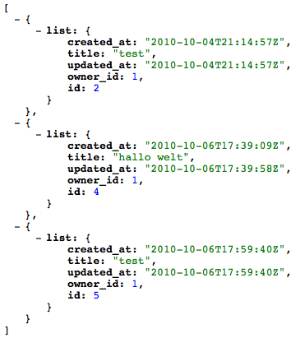
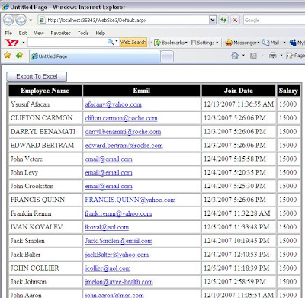
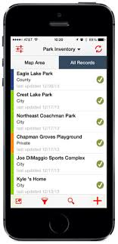
Why put the business logic in a separate class? The business logic class can be used by multiple front-end services.
class calculateTax(AccountObject a) {
public int getStatus() {}
public bool isOverdue() {}
public float getTax() { }
Web Front End
JSF xhtml code
JSON or XML
REST Service
Mobile App

Slide 16
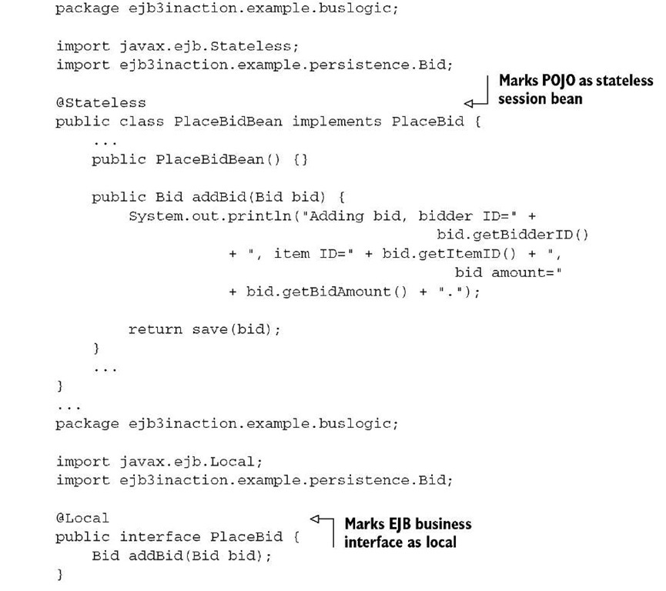
Example of Business Logic - a bidding system

Slide 17
What is Business Logic?
Unlike desktop applications, which are run from a local computer, web applications require a Web Server to host and serve up the application and require a web browser to render the application and interact with the user of the application.
Web applications are made up of a collection of static files (such as *.html, *.css, *.js, *.jpg) and dynamic files (such as *.jsp, *.xml, *.json) hosted on the Web Server.
The Web Server responds to HTTP requests and sends back HTTP responses.
Examples: Apache, Microsoft IIS, IBM WebSphere

Slide 18
What is an EJB?
An enterprise bean (EJB) is a server-side component that encapsulates the business logic of an application. The business logic is the code that fulfills the purpose of the application. It DOES NOT perform display of business data (presentation) or perform operations directly on the database (persistance) .

Slide 19
What is an EJB?
Is a POJO that uses specific annotations at the class and method level to mark it as an EJB.
Is managed (instantiated and destroyed) by an EJB Container.
There are number of variants:
Stateless Session: Keep state across method invocations (not widely used).
Stateful Session: Does not maintain state across method invocations (widely used).
Singleton: Only a single instance is every instantiated.
Message Driven: Used to process messages sent to it asynchronously.
Timer: Used to invoke business logic per a desired schedule.

Slide 20
The J2EE EJB Server or Container
An EJB container manages the enterprise beans contained within it.
For each enterprise bean, the container is responsible for registering the object, providing a remote interface for the object, creating and destroying object instances, checking security for the object, managing the active state for the object, and coordinating distributed transactions.

Slide 21
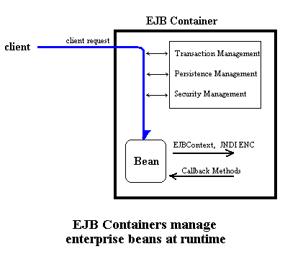
What is an EJB Container?
Remember, EJB is a specification and component managed by Jboss!

Slide 22
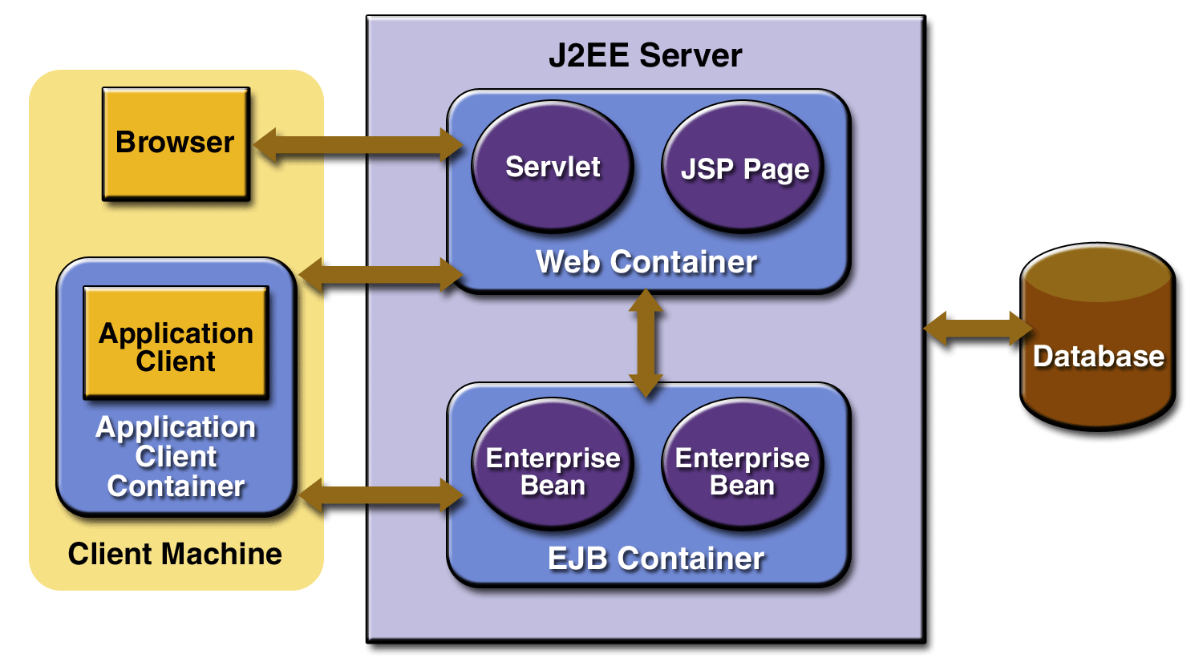
Are there other Containers in Java EE?
Remember, Servlet and JSP are specifications and component managed by Jboss!

Slide 23
What is Inversion of Control?
Inversion of control (IoC) is a programming technique.
IoC is expressed in terms of object-oriented programming in which object coupling is bound at run time by an dependent object that is typically not known at compile time using static analysis.
Use Cases:
Services such as Logging, Business Services, Data Access Services
Mock implementation for Test Driven Development or Unit Tests

Slide 24
What is CDI?
Primarily is used to support Inversion of Control (IoC).
Any Java class or EJB can be injected if it meets the following:
It is not a nonstatic inner class.
It is a concrete class or is annotated @Decorator.
It is not annotated with an EJB component-defining annotation or declared as an EJB bean class in ejb-jar.xml.
It has an appropriate constructor. That is, one of the following is the case:
The class has a constructor with no parameters.
The class declares a constructor annotated @Inject.

Slide 25
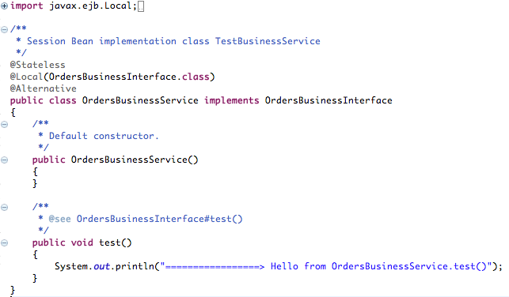
Can I see an example EJB?
Local Stateless EJB
Enable CDI Config to Inject Specific Concrete Class
POJO that implements a Java Interface

Slide 26
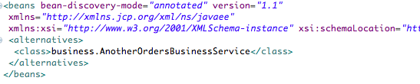
How can I configure and use CDI?
beans.xml
Resolve using annotations
Defines Concrete Class to use at runtime

Slide 27
Recall: Interface and Concrete class
Interface
Blueprint of a class. Contains a list of methods and properties but no code is written yet.
Class
Blueprint of an object. Methods are coded. Variables do not have values assigned yet. A class that implements interface must implements all the methods in interface.
Object Instance
Instance. Physical existence in memory. Variables are assigned. this.name = “shad”

Slide 28
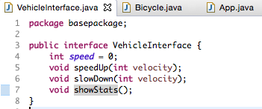
Recall: Interface and Concrete class
Interface
Class
Object Instance

Slide 29
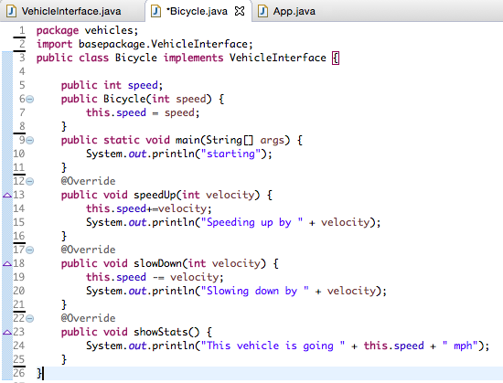
Recall: Interface and Concrete class
Interface
Class
Object Instance

Slide 30
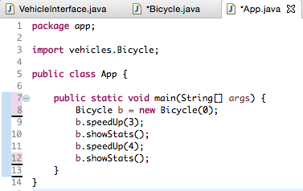
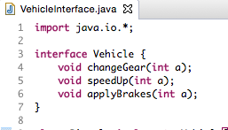
Recall: Interface and Concrete class
Interface
Object Instance

Slide 31
Recall: Interface and Concrete class
Interface
Object Instance

Slide 32
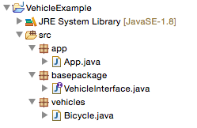
Recall: Interface and Concrete class
Interface
Class
Object

Slide 33
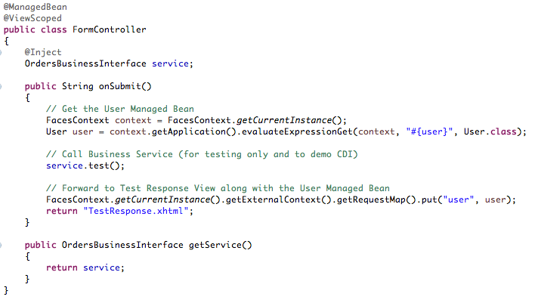
How do I “invoke” an EJB?
Inject Stateless EJB
based on CDI Config
Note, we are programming to Interfaces and NOT concrete implementation classes!
This allows the concrete class to be swapped out with a simple change of configuration in the beans.xml file
Remember, EJB is a specification and component managed by Jboss!

Slide 34
In-Class Activity
Code a Stateless EJB!
Complete the In-Class Activity #3a that I posted in an Announcement.
Implement a Java Interface class.
Implement an Order EJB.
Implement Another Order EJB.
Configure EJB’s.
Implement a JSF Login Page and Controller.
Invoke the EJB’s.
Take screen shots.

Slide 35
End of Class

Slide 36
In-Class Activity
Code another Stateless EJB!
Complete the In-Class Activity #3b that I posted in an Announcement.
Add new methods to a Java Interface class.
Update the Order EJB.
Update the Another Order EJB.
Configure EJB’s.
Call an EJB from JSF Orders Page and Controller.
Take screen shots.

Slide 37
End of Class

Slide 38
In-Class Activity
Code EJB’s or Work on Project!
Finish In-Class Activity #3a and #3b.
Work on design and implementation of Milestone Project.

Slide 39
Weekend Reminders
Continue to work on the design and code for your Milestone Project.
Submit In-Class Activity #3a and #3b to the Main Forum.

Slide 40
End of Class

Slide 42
Lectures for Topic 3 – Week 2
Lecture:
Timer Beans.
Hands On:
Build a Timer EJB.

Slide 43
Timer EJB

Slide 44
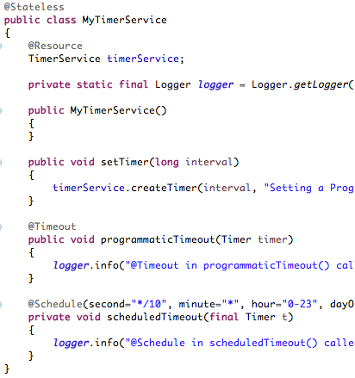
What is a Timer EJB and how to I configure?
Stateless EJB
Is a Stateless EJB.
Injects the standard TimerService as a Resource into the EJB.
Can use method annotations to define One Shot or Scheduled Periodic methods to be invoke BY the EJB Container.
Timer Resource
One Shot Timer
Scheduled Periodic Timer

Slide 45
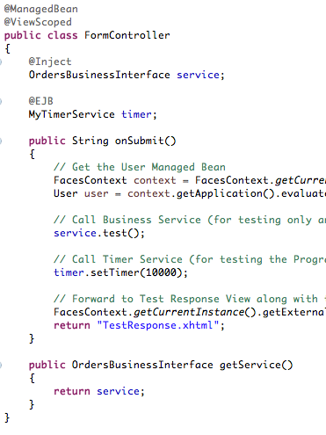
Can I see an example Timer EJB?
Create a Timer EJB.
One Shot
Periodic
Run Business Logic
Asychronous
Inject into your code like you would any other EJB.
Inject Timer EJB

Slide 46
In-Class Activity
Code a Timer EJB!
See the In-Class Activity #3c that I posted in an Announcement.
Create a Timer EJB.
Configure the Timer EJB from a JSF Controller.
Run the Timer EJB.

Slide 47
End of Class

Slide 48
In-Class Activity
Code a Timer EJB or Work on Project!
See the In-Class Activity #3c that I posted in an Announcement.
Work on design and implementation of Milestone Project.

Slide 49
End of Class

Slide 50
In-Class Activity
Work on Project!
Work on design and implementation of Milestone Project.

Slide 51
Weekend Reminders
Submit Milestone Project.
Submit In-Class Activity #3c in Main Forum.

Slide 52
End of Class

